Slide 1
How Many Licks?
Taylor Walton
Coordinating Seminar

Slide 2
Activity
Determine the rate of change of the volume of a Tootsie Roll Pop as you consume it.
Goals:
Students will calculate the radius of a sphere.
Students will determine the rate of change using collected data.
Objectives:
Given a lollipop and the appropriate materials, students will determine the rate of change of the lollipop’s volume with 90% accuracy.

Slide 3
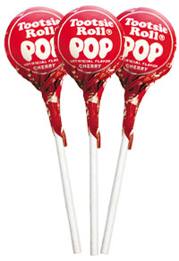
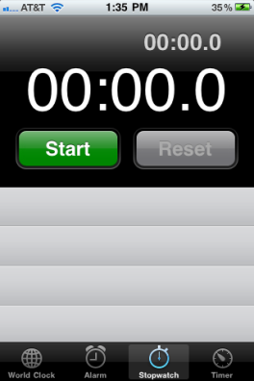
Materials
Tootsie Roll Pop
String
Ruler
Timer
Graphing Calculator
Paper
Pencil

Slide 4
Procedure
Step 1
Measure the initial circumference of your pop:
Wrap the string around the middle of your lollipop
Mark where the measurement is on your string
Lay the string flat on your ruler
Record the measurement

Slide 5
Step 2
Place the lollipop in your mouth
Start a timer for 30 seconds
Begin to consume the lollipop
Take the lollipop out at the end of the 30 seconds
Repeat step 1 with the new circumference

Slide 6
Step 3
Repeat Steps 1 and 2 until you have collected data for 300 seconds
Time (Seconds) | Circumference (centimeters)
0 | 10.2
30 | 9.8
60 | 9.2
90 | 8.4
120 | 8.1
150 | 7.6
180 | 7.3
210 | 6.5
240 | 6.2
270 | 5.7
300 | 5.2

Slide 7
Step 4
What to do when you get to the center of your lollipop…
Using the data you have collected, determine the radius of your lollipop at each time increment
$$r= \frac{C}{2π}$$
Time (Seconds) | Circumference (centimeters) | Radius $$\frac{C}{2π}$$
0 | 10.2 | 1.623
30 | 9.8 | 1.559
60 | 9.3 | 1.480
90 | 8.6 | 1.369
120 | 8.1 | 1.289
150 | 7.6 | 1.209
180 | 7.3 | 1.162
210 | 6.5 | 1.035
240 | 6.2 | .987
270 | 5.7 | .907
300 | 5.2 | .828

Slide 8
Step 5
Using the data from your table, create a scatter plot of the radii with respect to time (t)
Find the Line of Best Fit for your data:
$$y=−.00268x+1.625$$

Slide 9
Data Analysis
$$y=−.00268x+1.625$$
$$r(t)=−.00268t+1.625$$
Is your equation reasonable?
$$r\left(30\right)=−.00268\left(30\right)+1.625$$
$r=1.545$ cm
Compared to 1.559 cm from our data ✔
$$r\left(210\right)=−.00268\left(210\right)+1.625$$
$r=1.0622$ cm
Compared to 1.035 cm from our data ✔

Slide 10
Data Analysis
How fast does the volume of the Tootsie Roll Pop decrease when the radius is ¼ its original value?
Find the rate of change of the volume
$$V= \frac{4}{3}πr^{3}$$
$$\frac{dV}{dt}=\left(3\right)\frac{4}{3}πr^{2}\left(\frac{dr}{dt}\right)$$
$$\frac{dV}{dt}=4πr^{2}\left(\frac{dr}{dt}\right)$$

Slide 11
Data Analysis
How fast does the volume of the Tootsie Roll Pop decrease when the radius is ¼ it’s original value?
$$\frac{dV}{dt}=4π{\left(\frac{1}{4}r\right)}^{2}\left(\frac{dr}{dt}\right)$$
$=4π{\left(\frac{1}{4}\left(1.623\right)\right)}^{2}\left(\frac{dr}{dt}\right)$
$=4π{\left(\frac{1}{4}\left(1.623\right)\right)}^{2}\left(−.00268\right)$
$=−.0055444914 {cm}^{2}$
$=−.0055 {cm}^{2}$
Time (Sec) | Circumference (cm) | Radius $$\frac{C}{2π}$$
0 | 10.2 | 1.623
$$r(t)=−.00268t+1.625$$

Slide 12
Extension
How would the rate of change for the volume change if you had a lollipop with a larger radius?
What about with a smaller radius?
What would happen if the rate of change was larger?
How about if it were smaller?

Slide 13
Evaluation
Report throughout the activity
Worksheet

Slide 14
Resources
http://www.finneytown.org/Downloads/Lollipop%20Lab.pdf
http://prezi.com/4r-5nspxuntx/lollipop-lab/

